Slide 1
Members and Casual differences
By: David Lincoln
Date: 12/30/2022

Slide 2
OUTLINE
Background
Business objective
Description
Key Findings
Recommendations

Slide 3
Background
In 2016, Cyclistic launched a successful bike-share offering With a growing fleet of 5,824 bicycles that are geotracked and locked into a network of 692 stations across Chicago.
The bikes can be unlocked from one station and returned to any other station in the system anytime.

Slide 4
Business Objective
Design marketing strategies aimed at converting casual riders into annual members.
How does annual members and casual riders use cyclistic bikes differently?

Slide 5
Description
Historical trip data from the company ‘Divvy Bikes’ were used to conduct this analysis
Historical day from the previous 12 months from May 2020 – Apr 2021
Resources
https://divvybikes.com/
https://divvy-tripdata.s3.amazonaws.com/index.html/

Slide 6
KEY FINDINGS

Slide 7
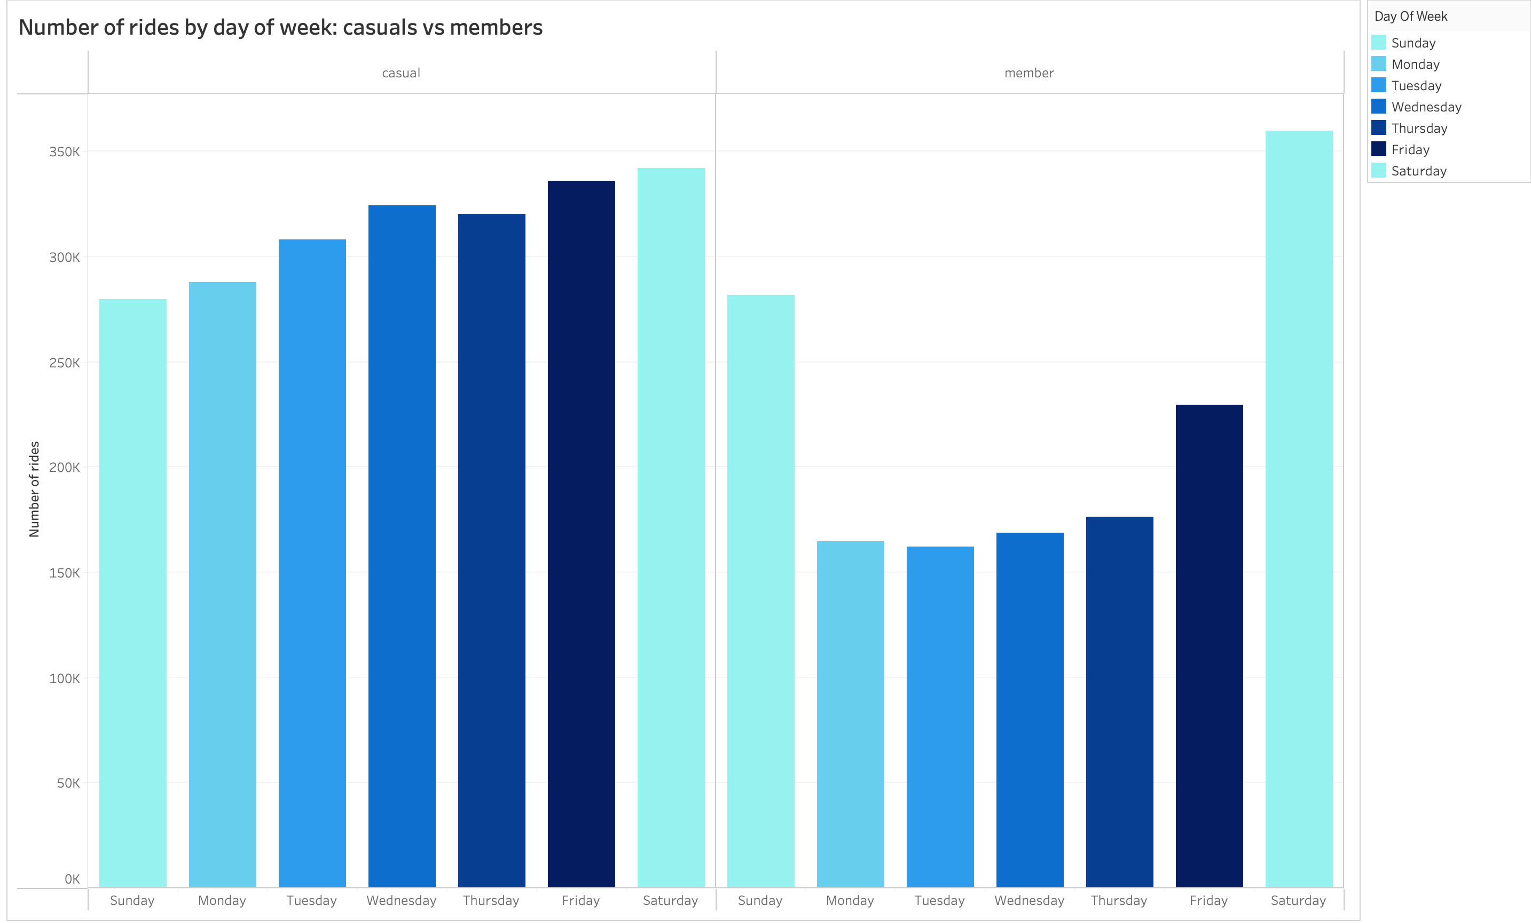
Number of Rides by Week
- Annual members showed consistent number of rides during weekdays compared to casual riders
Annual members has an increase of number of rides during the weekends

Slide 8
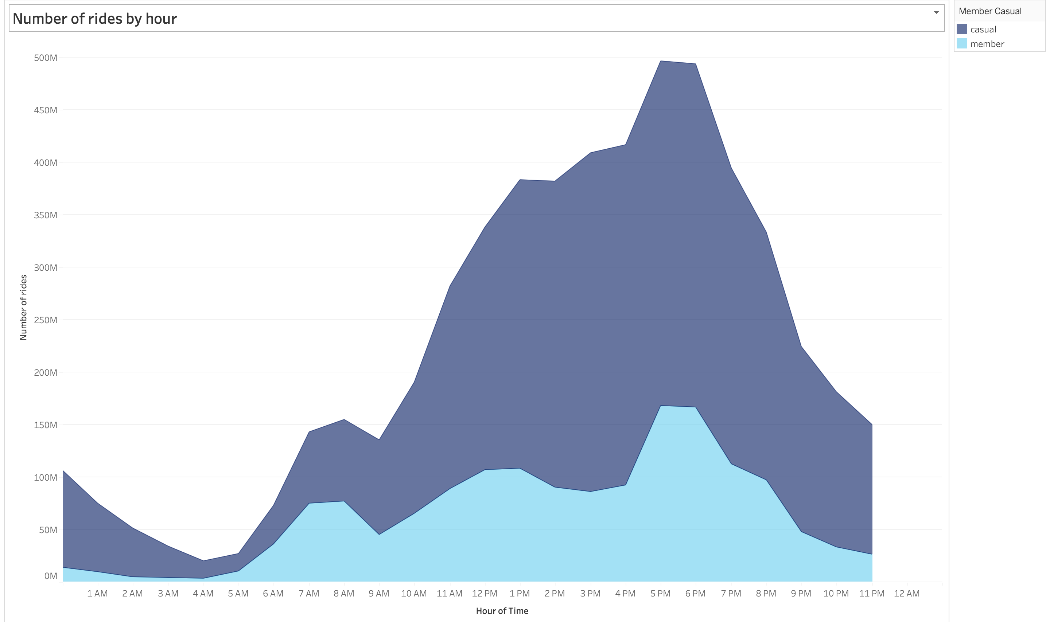
Number of rides by time of day
Annual members show a decrease in rides between 1PM-5PM
Casual Riders show an increase in rides between 1PM-5PM

Slide 9
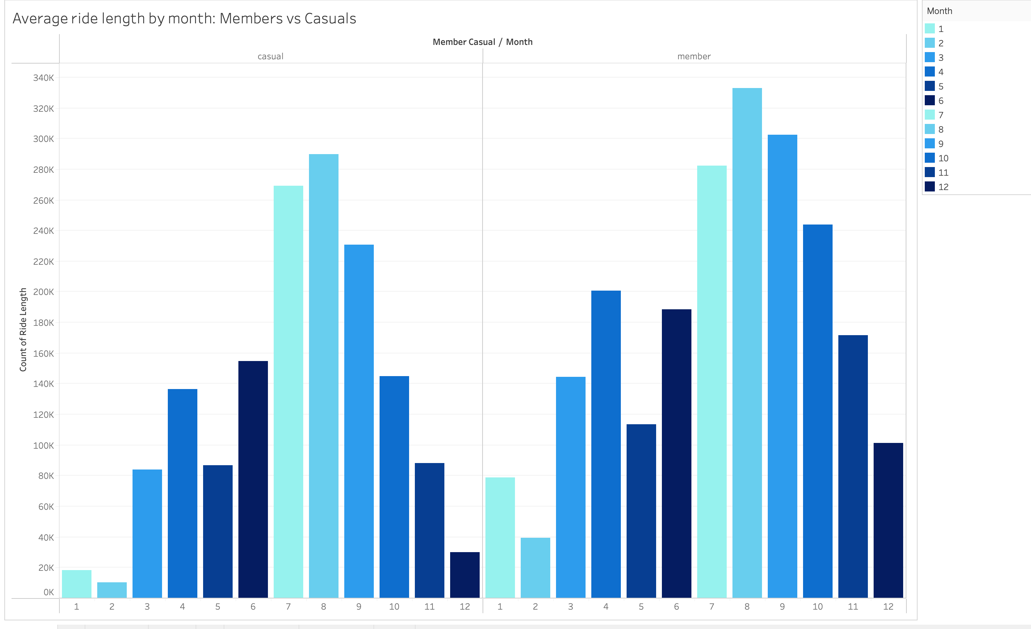
Number of rides: by month
Annual members show an increase of rides in winter months compared to casual riders

Slide 10
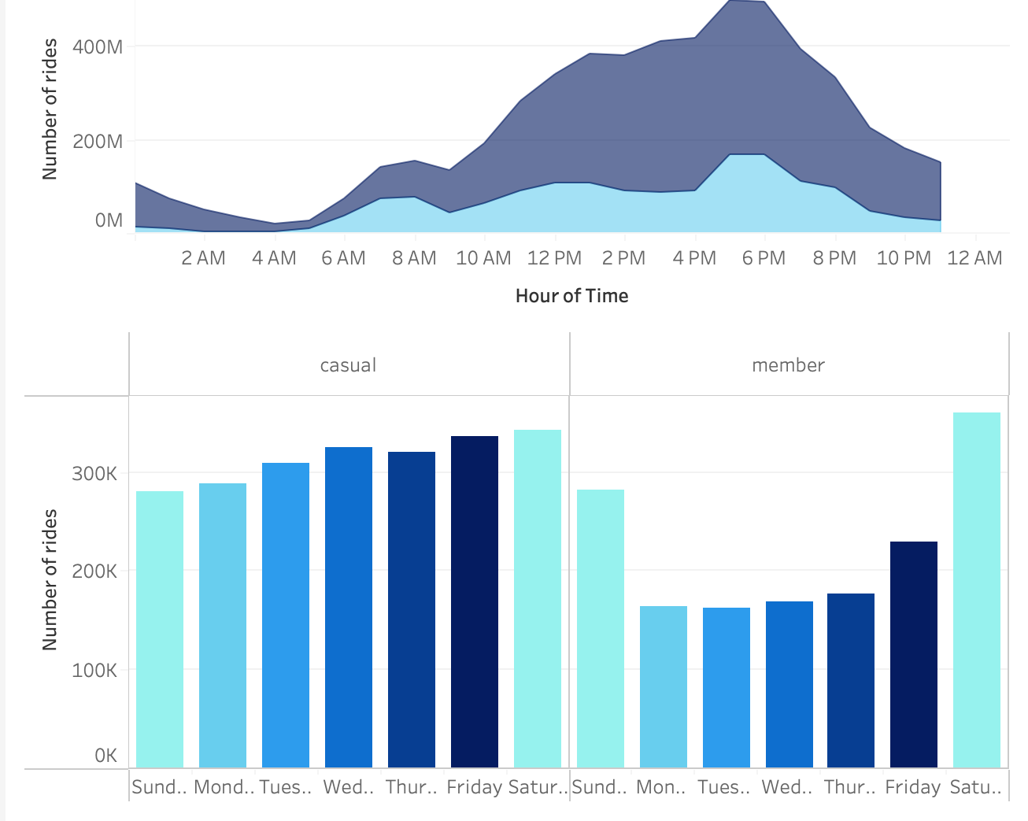

Slide 11
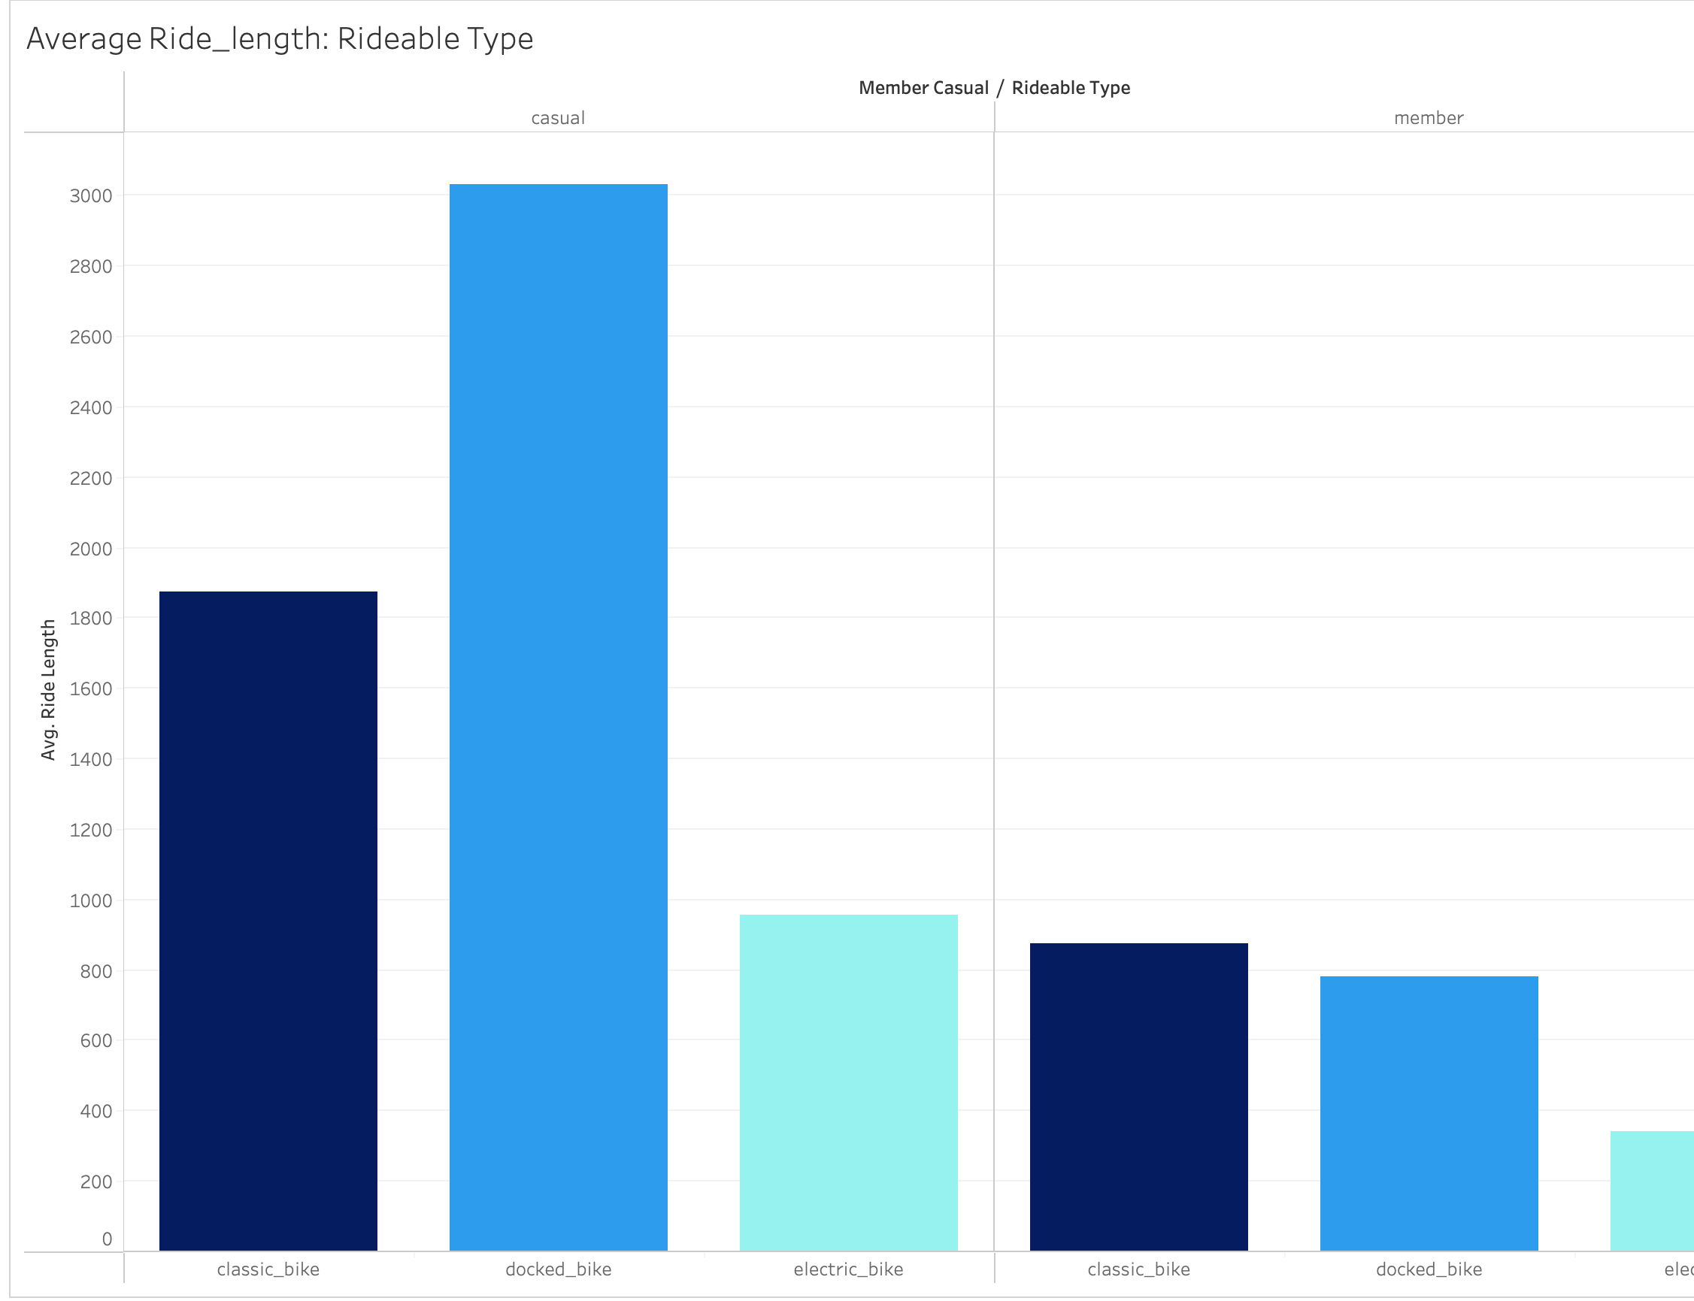
Ride type member casuals
Classic, and Docked bikes are the popular choice for both Annual members and Casual riders
Classic bikes are the most popular choice among Annual members
Docked bikes are the most popular choice among Casual riders

Slide 12
RECOMMENDATIONS

Slide 13
TAKE AWAYS
ANNUAL MEMBERS USE CLASSICAL BIKES CONSISTENTLT THROUGHOUT THE WEEKDAYS
ANNUAL MEMBERS SHOW AN INCREASE IN WEEKEND RIDE ACTIVITY
CLASSICAL BIKES ARE THE MOST POPULAR CHOICE AMOUNG ANNUAL MEMBERS

Slide 14
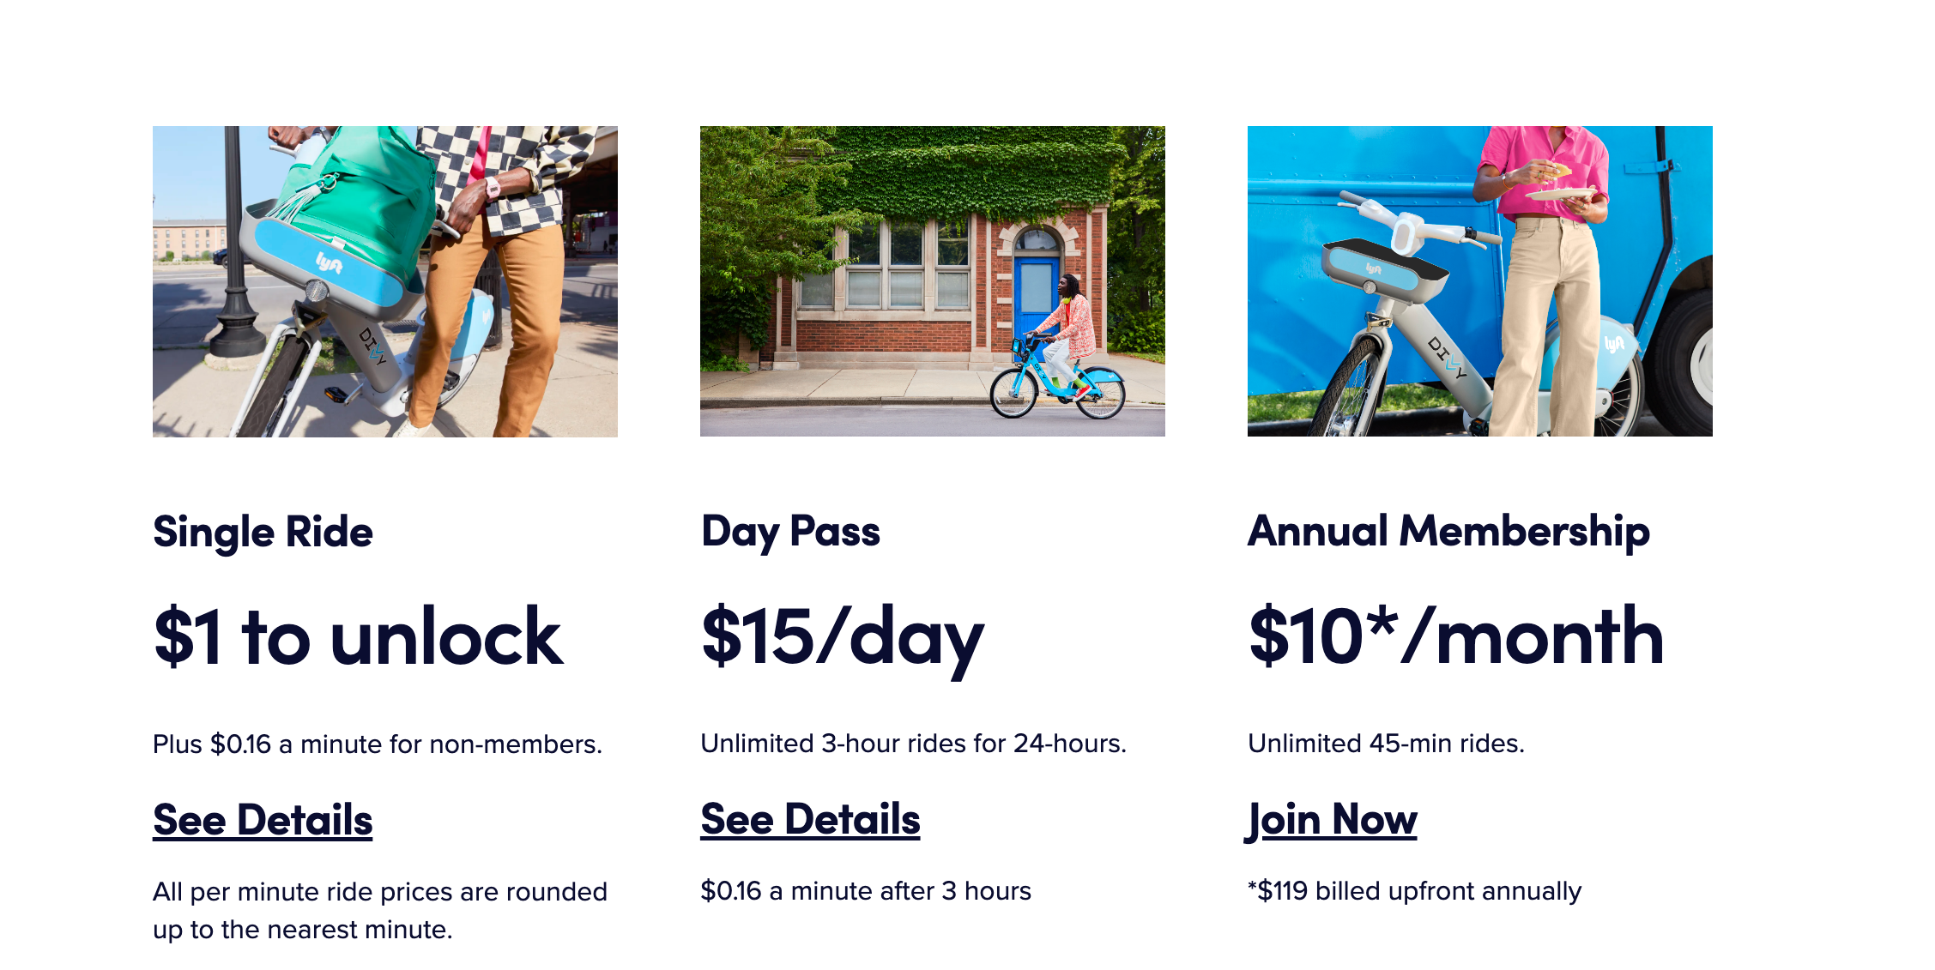
FLEXIABLE PRICING
ANNUAL MEMBERSHIPS SAVE CUSOMTERS $410 PER MONTH & $5210 per year
OVER 200% IN SAVINGS

Slide 15
MARKETING STRATEGIES
MARKET TOWARDS CASUAL RIDERS THAT RIDE CLASSICAL BIKES CONSISTENTY THROUGH THE WEEKDAYS FOR OVER A MONTH
EMPHESIS MONTHLY AND ANNUAL SAVING PERCENTAGES COMPARED TO THE DAY-PASS
WEEKEND PRICE SPECIALS CAN HELP ATTRACT NEW ANNUAL MEMBERS
RELIABILITY OF THE CLASSICAL AND DOCKED BIKES DURING WINTER MONTHS CAN HELP CONVERT CASUAL RIDERS TO ANNUAL MEMBERS

